Slide 1






TOMATO CLOCK EXTENSION

Slide 2

INTRODUCTION
Based off of the Pomodoro Timer, Tomato Clock is a productivity extension that allows you to time yourself for 25 minute intervals, and take 5 minute breaks after each one. Maximize your concentration and productivity with this web extension!

Slide 3
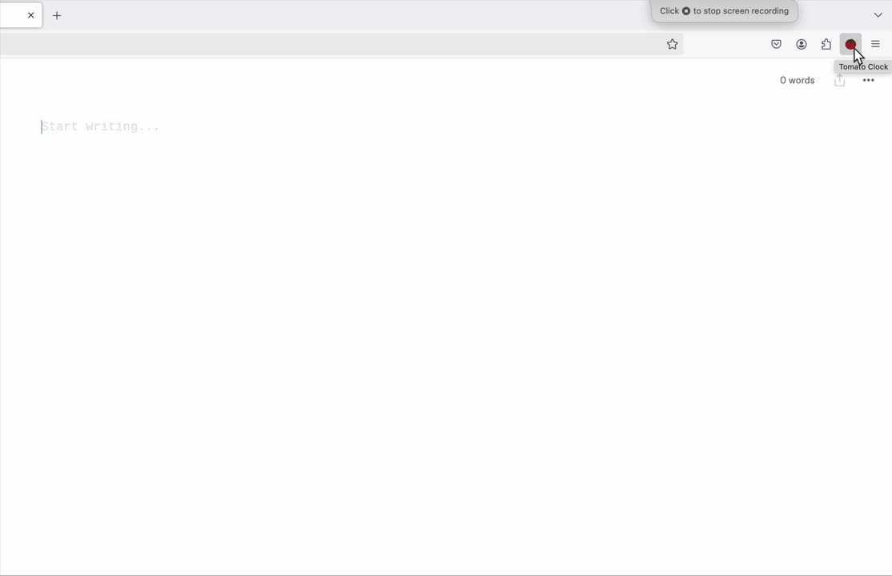
DEMO

Slide 4
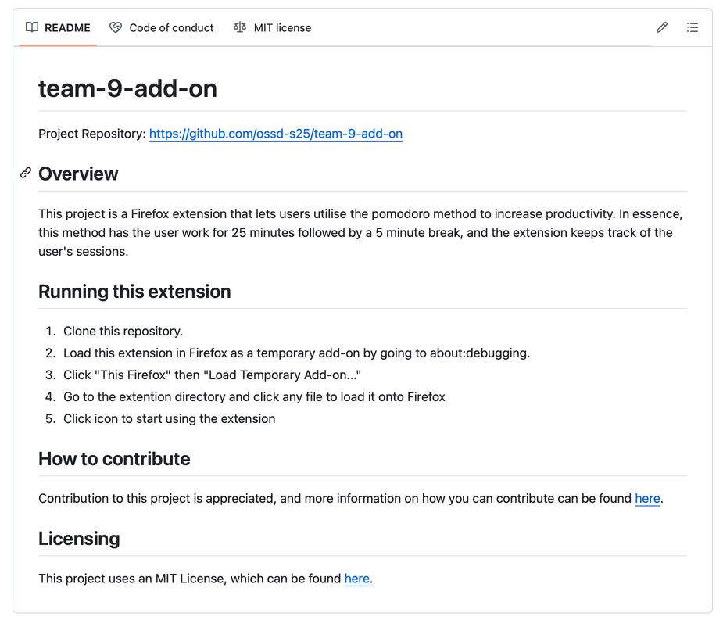
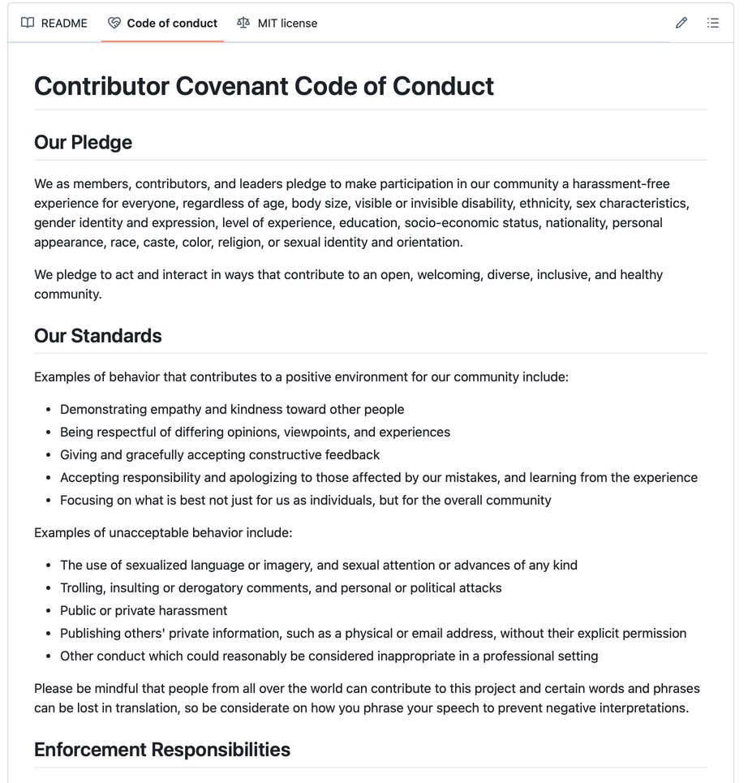
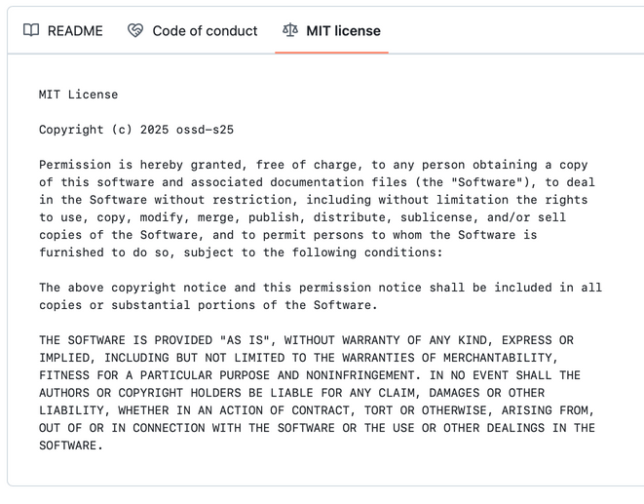
OPEN SOURCED

Slide 5
THANK YOU

